Slide 1
Bell Work
Please install the following programs into your personal computer.
Git
Visual Studio Code
Node and npm that comes with it
GitKraken

Slide 2
CODING 101
Welcome to West-MEC

Slide 3
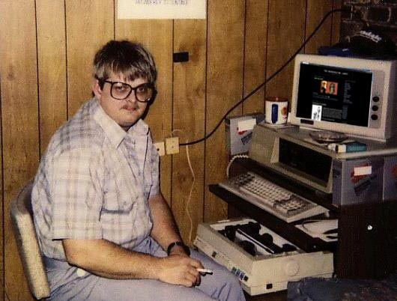
I am Mr. Peck
I am here to help you become a master coder.
If you ever need to reach me, you can email me at :
kyle.peck@west-MEC.org
Or on slack (I’ll get to that later)

Slide 4

Start of Class Procedures
As soon as you log into zoom for the day, please do the following:
Log into Google Classroom
Open Gmail
Open github/gitkraken
Once you have done that you can do the bell work that will be on Google Classroom

Slide 5

Creating Github Accounts
Please log into github and create an account with your personal email.
This account can be used in the future so please don’t use your west-mec account since that will vanish after you leave

Slide 6
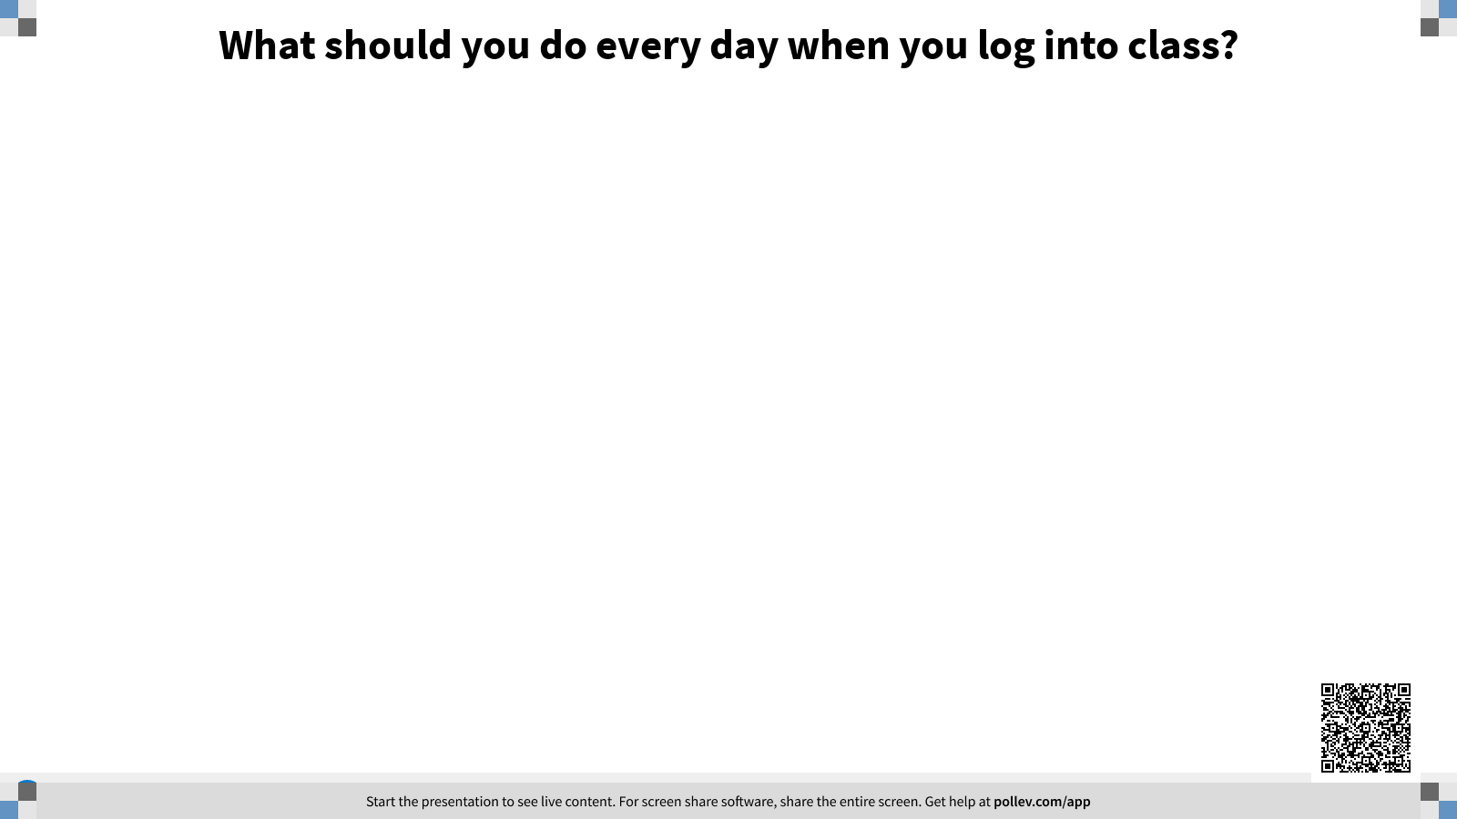
Attention Check

Slide 7

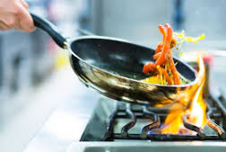
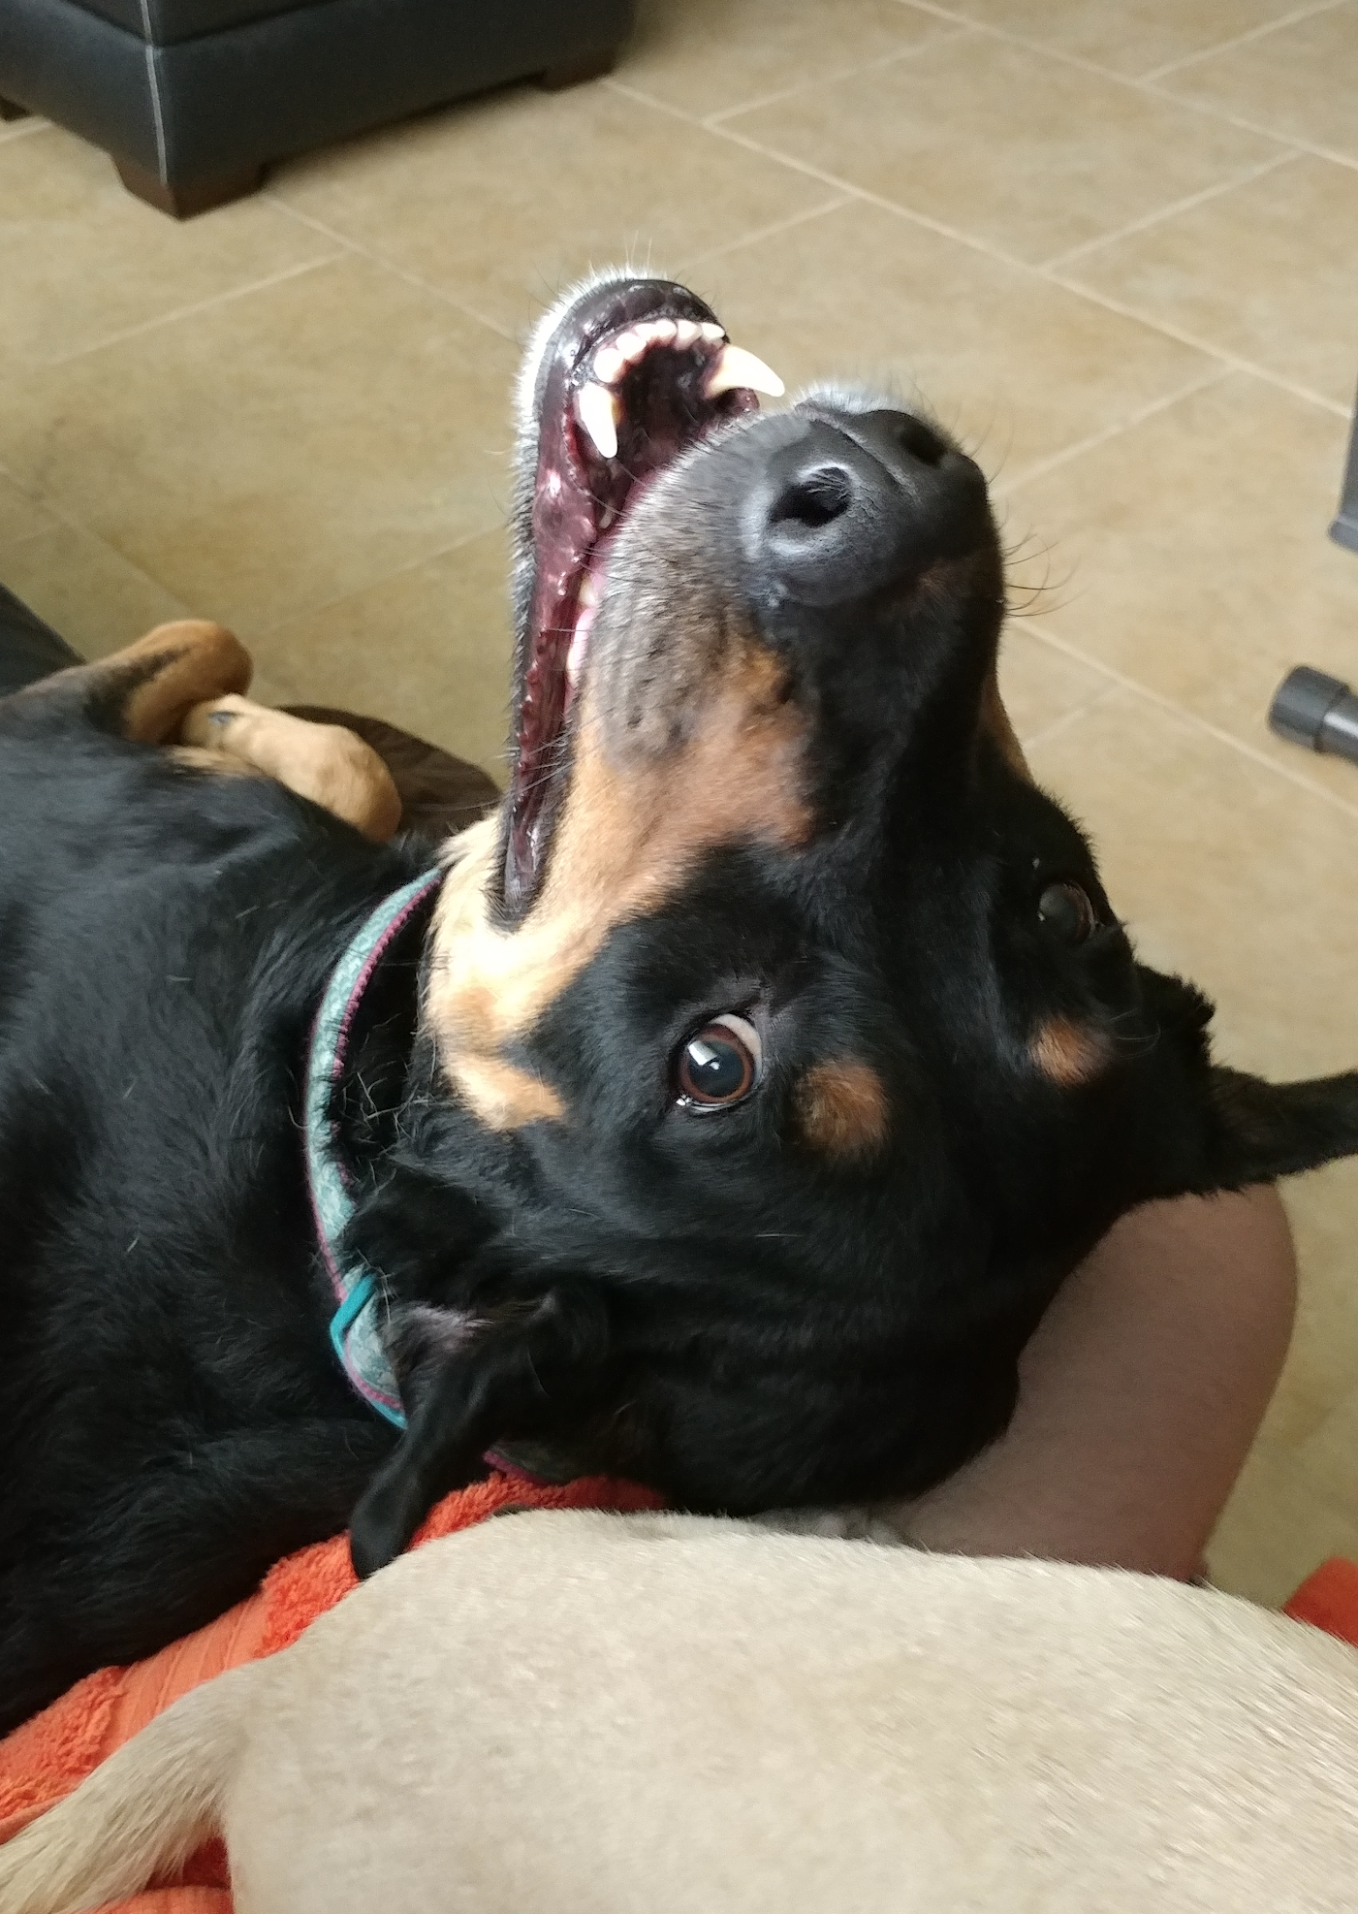
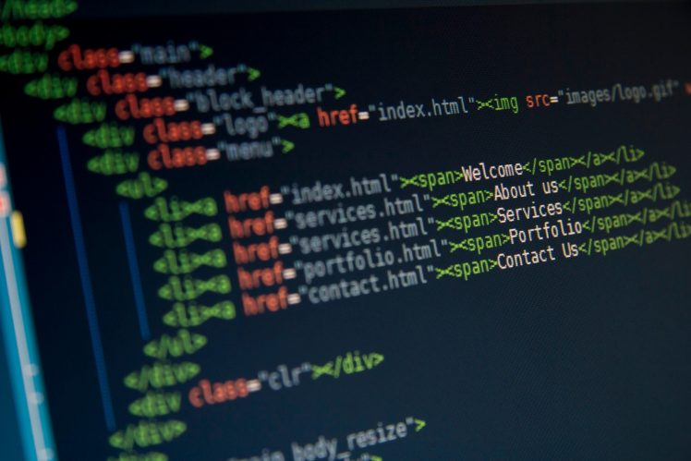
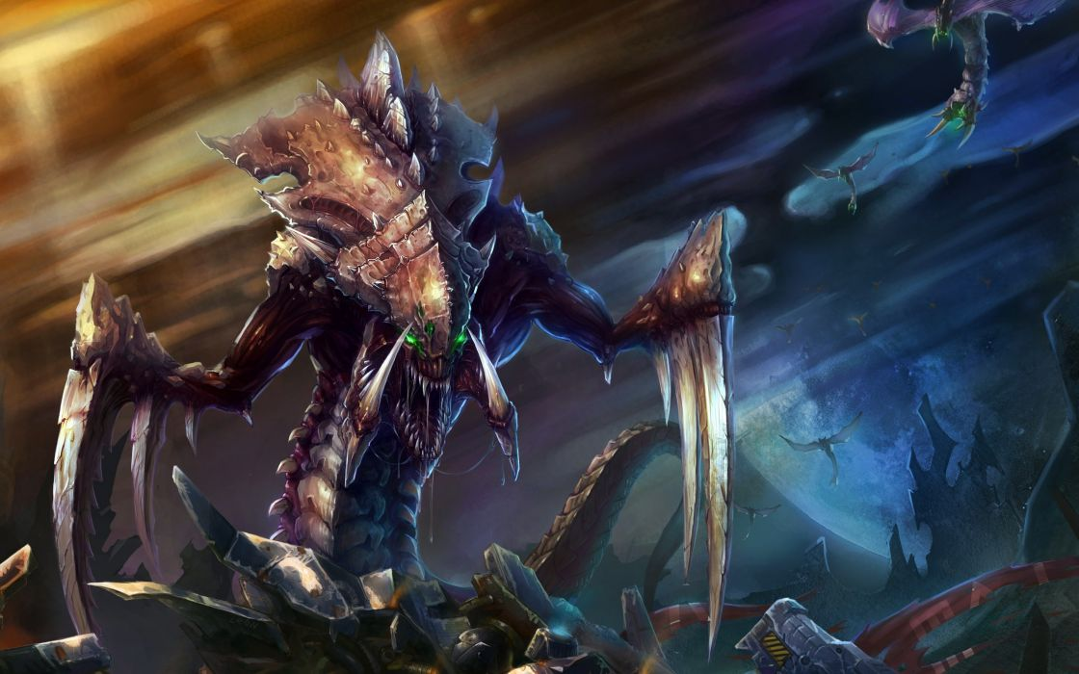
let job = (x, y);
x = coding
y = instructor

Slide 8
Students Slides

Slide 9
<h1> YOUR NAME </h1>
<p> Here you will write about something that you are into </p>
ADD ANOTHER GRAPHIC
PICTURE OF YOU
GRAPHIC
<p> Here you will tell us something that you are super stoked about for the upcoming year </p>

Slide 10
Stuff you should know for this class
Attendance
Graded Work
Bell Work
I will be taking attendance 3 times a day. If you aren’t available for all 3 of those check ins you will be marked down as tardy or absent.
IF YOU NEED TO LEAVE BRIEFLY JUST PRIVATELY MESSAGE ME!
If you say nothing I can’t help you.
I will be grading as often as I can. Please feel free to remind me if its been more than a few days.
If the work is assigned I will likely grade it. I don’t want you to waste your time
Bell work will be anything from a simple question to a mini project.
Many times what we do during the bell work will be directly related to the day’s work, so if you don’t do it you will be behind

Slide 11
Laptops and Computers
Hopefully is you are reading this you already have a computer or a laptop.
You don’t need anything crazy for the year one course.
If you don’t think your computer will cut it please tell me asap and we can get you a brand new one.

Slide 12
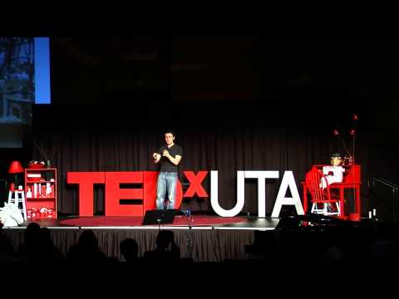
Some Inspiration Before We Begin

Slide 13
I.T. is your best friend
It doesn’t matter who runs IT they are always your best friend. Treat them well and they will always help you first.

Slide 14
Classroom Mission & Vision
Mission - Common goal or purpose
What do you want to gain from this class?
Where do you want to end up after this class?
Vision - What inspires us?
How are we going to achieve our mission?
What do we believe to be the best qualities?

Slide 15
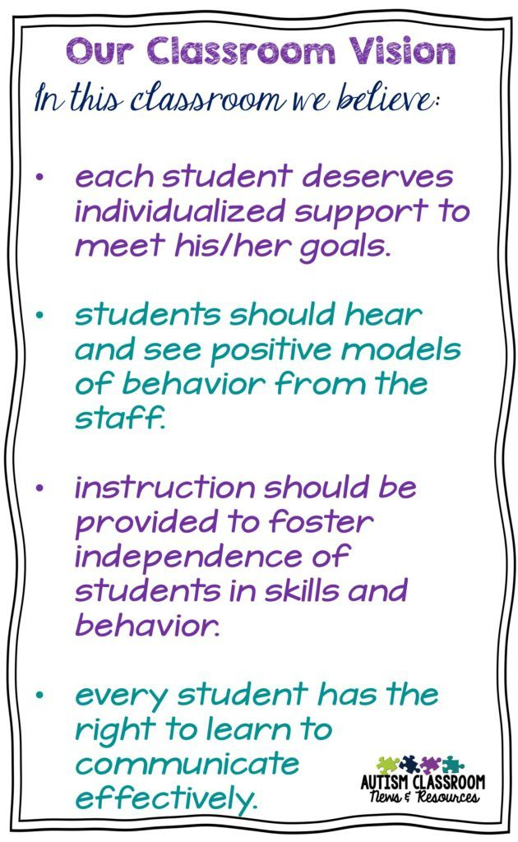
Classroom Mission & Vision
Mission - Everyone Learns Everyday
Vision - We are confident, centered, intelligent, mature, positive, critical learners.
LIMIT - THIS SHOULD NOT BE MORE THAN 1 SENTENCE

Slide 16
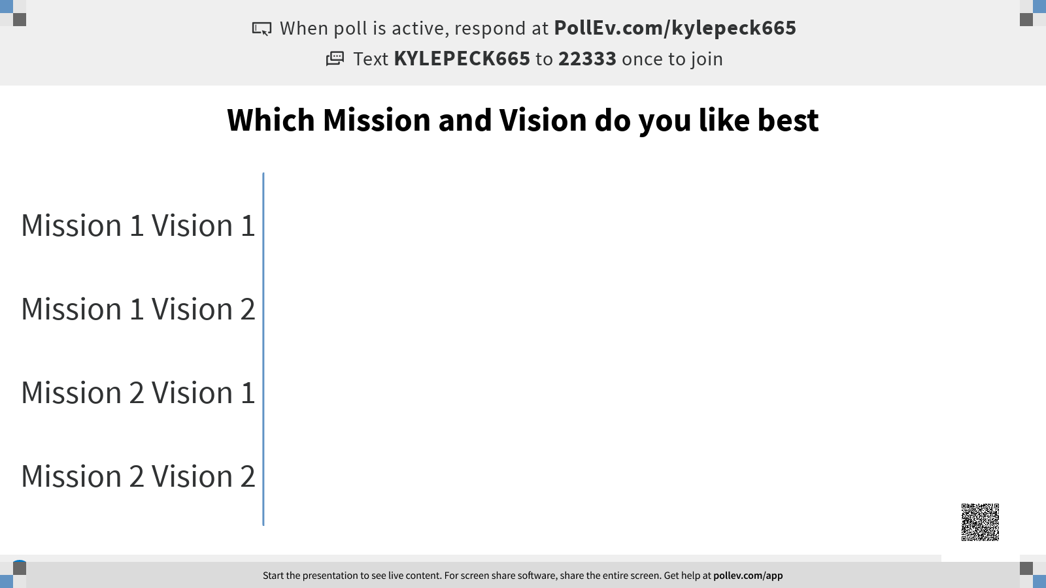

Slide 17
Class Time
projects
Class work
Assessments
Direct Instruction
Active Engagement
Career Based Experiences
We will have a hands-on project after every unit to practice what we learned
We will work together on several projects during notes to break up the boredom
There will be quizzes and test through the year as well as a final and midterm
Sorry, bu there will be notes and plenty of them, I will try to break them up but they aren’t as fun as the rest of class
Sometimes during class we will get up, move around, talk, and even learn with each other. You are expected to participate in these activities
We will be trying to get speakers and internships. I recommend you take part in as much as you can while its free.

Slide 18
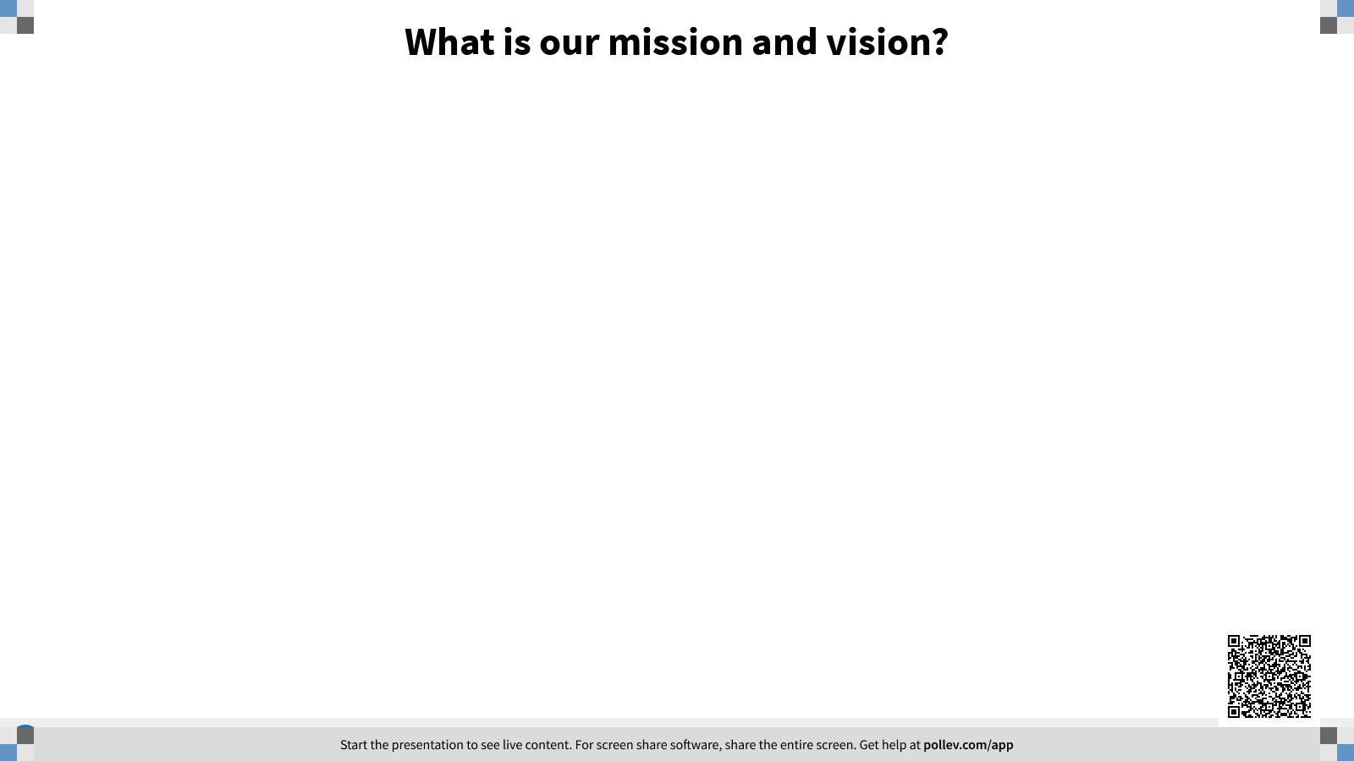
Attention Check

Slide 19
How to be a Ninja Coder
(satire)
Thank you to javascript.info
© 2007—2020 Ilya Kantor

Slide 20
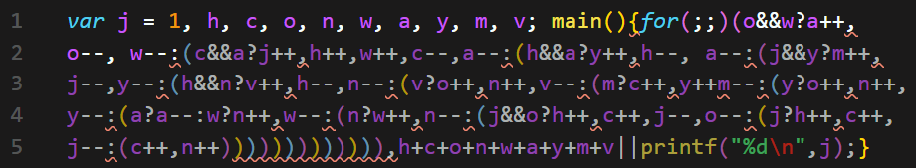
Brevity is the soul of wit
The shorter your code is, the better.
Programmers love puzzles and deciphering your code is really fun for others.

Slide 21
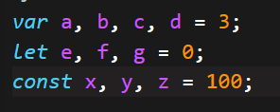
Waste Not, Want Not
Don’t waste your time coming up with longer names for variables when a single letter is all you really need. Code takes long enough to write
Use the same variable multiple times for holding different values.
Plus, if they just took the time to look at your code the variables are obvious.

Slide 22
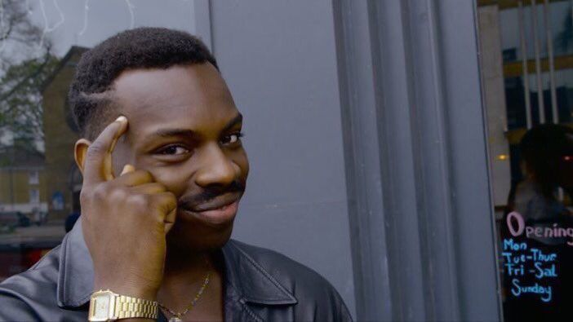
Complexity is a Synonym for Intellectual
Make your variables and code abstract.
your variable name can’t be wrong if it’s name could be used for everything.
Try names like num1, num2, string, and array.

Slide 23
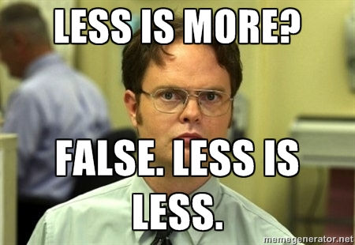
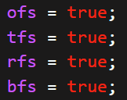
Short and Sweet
If you need to use more than 1 letter, let’s assume both words start with the same letter, then make sure you use abbreviations.
It’s easy to guess what you mean. There aren’t that many things it could be.

Slide 24
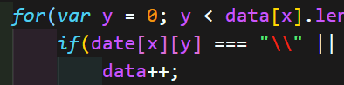
Keep Aware
To make sure that your reader is paying close attention use variable names that are close to each other.
Like date and data.
Make sure that you use them together as much as you can. A ninja enjoys the practice and the challenge

Slide 25
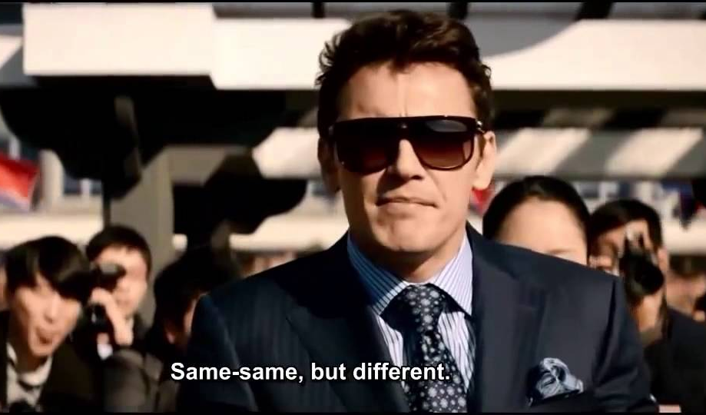
Same Same, but Different
Use variable names and function names that mean the same thing but do different things.
function showName();
function displayName();
function printText();
function printPage();

Slide 26
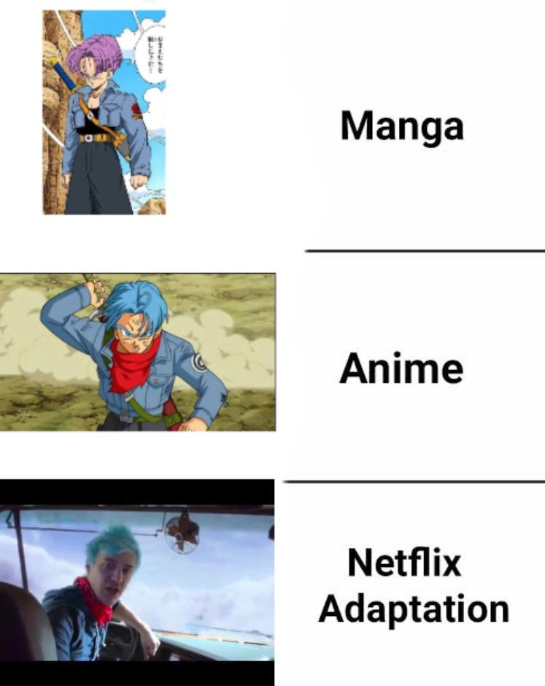
Adaptation and Exaptation
Reuse the variables that you already have, once they have served their purpose they are free to become any other value you need.
Don’t forget about the old variables when they are done working.
They will be sad, cold and alone.

Slide 27
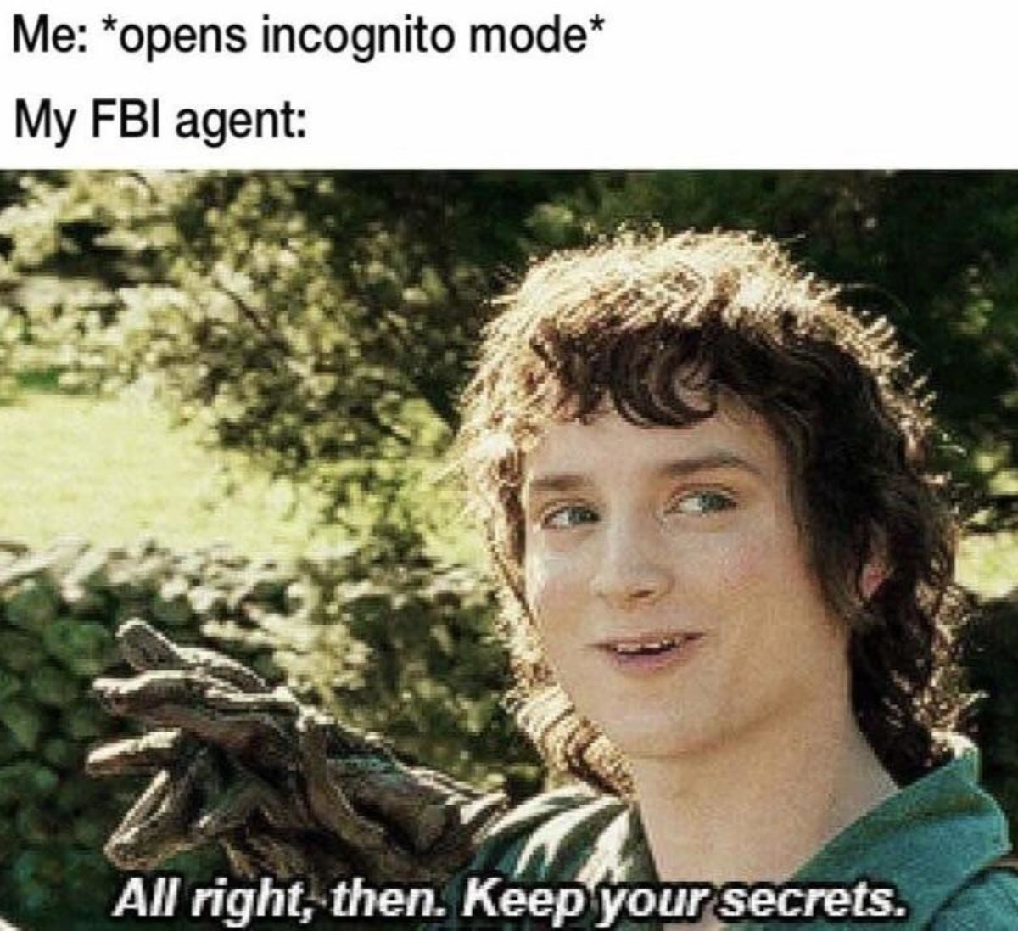
Stealth Letters (underscores)
Sometimes you already have the perfect name for a variable but it’s already being used.
That’s no problem for a ninja, just add an underscore to it. name and __name are clearly different and that way everyone knows what’s in the variable

Slide 28
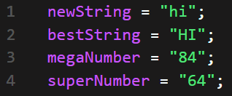
Use Adjectives
You need to let your readers know what is important and not important in your code, words like ultra, best, biggest, weak will help people know what is really important at a quick glance.

Slide 29
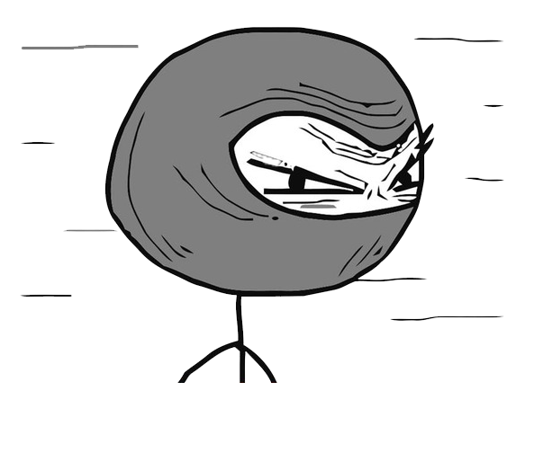
The Ninja Way
To be a true ninja, you must remain hidden. When you are found you need to confuse and mislead who ever is watching. The harder is to understand your work and the less you are noticed, the less likely it is for someone to steal your work.
If you follow all of these rules, you will be a true Ninja Coder.

Slide 30
In case you don’t get it yet...
PLEASE DON’T DO ANY OF THOSE THINGS

Slide 31
It’s not a waste,
code is free
Use unique names
Name them clear and long enough to mean something
Don’t use underscores unless you are creating constant values
Don’t reuse your variables
Use comments when you need to describe your code more than a variable name can do

Slide 32
You're not impressing anyone with your short code so stop trying
While making compact and efficient code is important, the most important thing you can do is make your code readable.
AND DON’T FORGET TO USE COMMENTS!

Slide 33
Exception
Some abbreviations are known by coders and they are accepted but you should always try to avoid them.
For example “i” stands for “interval” and/or “index”, that has been agreed on.
But if you say str is that “strength” “string” “strange” “start”

Slide 34
Ninja Code Quiz
Answer like a coder, not a ninja

Slide 35
Bell Work
WELCOME TO DAY 2
Please log into google classroom, open the Active Engagement Sheet and start filling that sheet out. We learned a lot yesterday so you should be able to do about half of it.

Slide 36
Syntax
Just a short intro

Slide 37

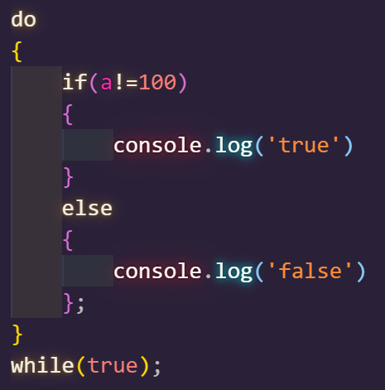
White Space
White space is only there for human readers
The purpose of white space is to make your code more readable and easier to understand
Times you should ALWAYS have white space
Around operators
Before and after brackets
At the end of every line of code.

Slide 38
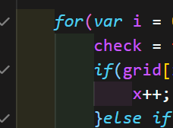
Indents
The spaces in front of code, helps find nested statements.
Everytime you make a new container you need to leave indents
If you don’t leave indents it will be very difficult to read your code

Slide 39
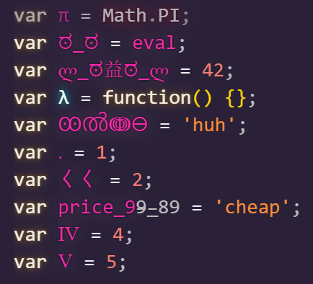
Naming
There are a few rules of naming
Always make them specific
They cannot start with a number
They cannot have spaces
Variables are case sensitive
They can only contain numbers, letters, and dollar signs.
Many words are reserved (google those)
Special characters are allowed

Slide 40
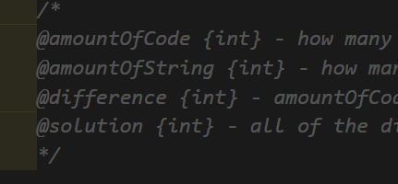
Comments
Comments are extremely important.
There is a universal agreement on the best way to document your code called JSdoc (more on this later)

Slide 41
Terminal Commands
cd..
Moves you back one level
cd *
Moves you forward to the directory you type
dir
Will list every directory in your current directory
mkdir
Will create a new directory where you are

Slide 42
File Directory Setup
CS 101
UNIT 0
EXERCISES & PROJECTS

Slide 43
Directory set up
Navigate to the desktop directory
Create a directory named CS 101
Create a directory in CS 101 named unit 1
Create a directory in unit 1 named exercises

Slide 44
Bell Work
WELCOME TO DAY 3
Please check Google Classroom and get your copy of the “who you are…” document and begin writing.

Slide 45
FINAL MISSION AND VISION
Mission 1: Learn coding in order to better our lives down the line
Vision 2: is to become successful computer programmers and prosper in our fields

Slide 46
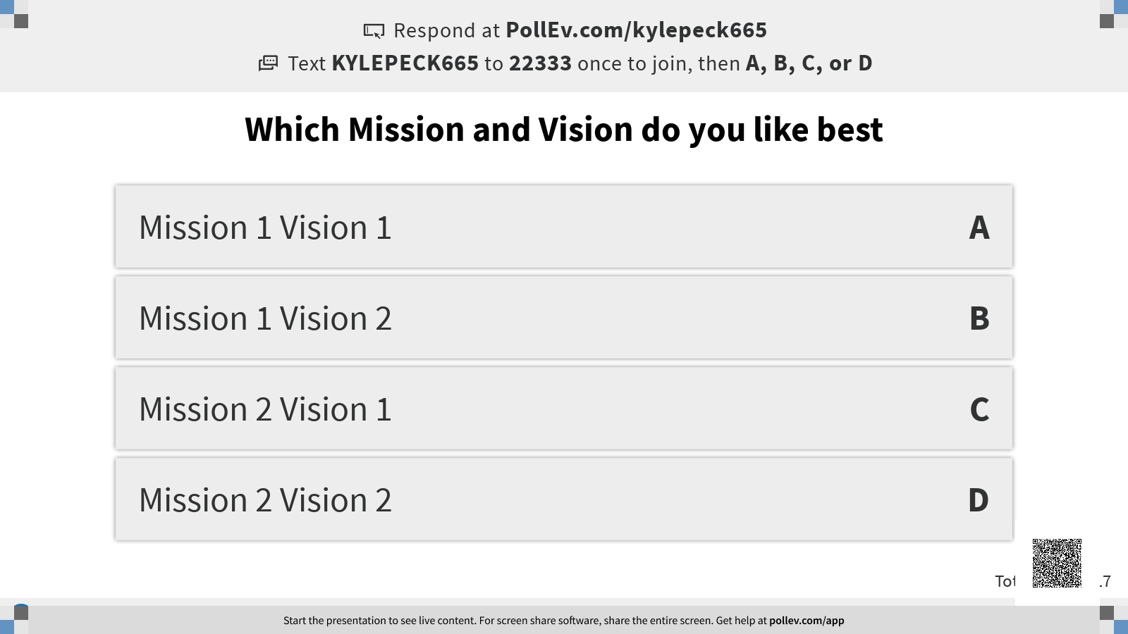

Slide 47
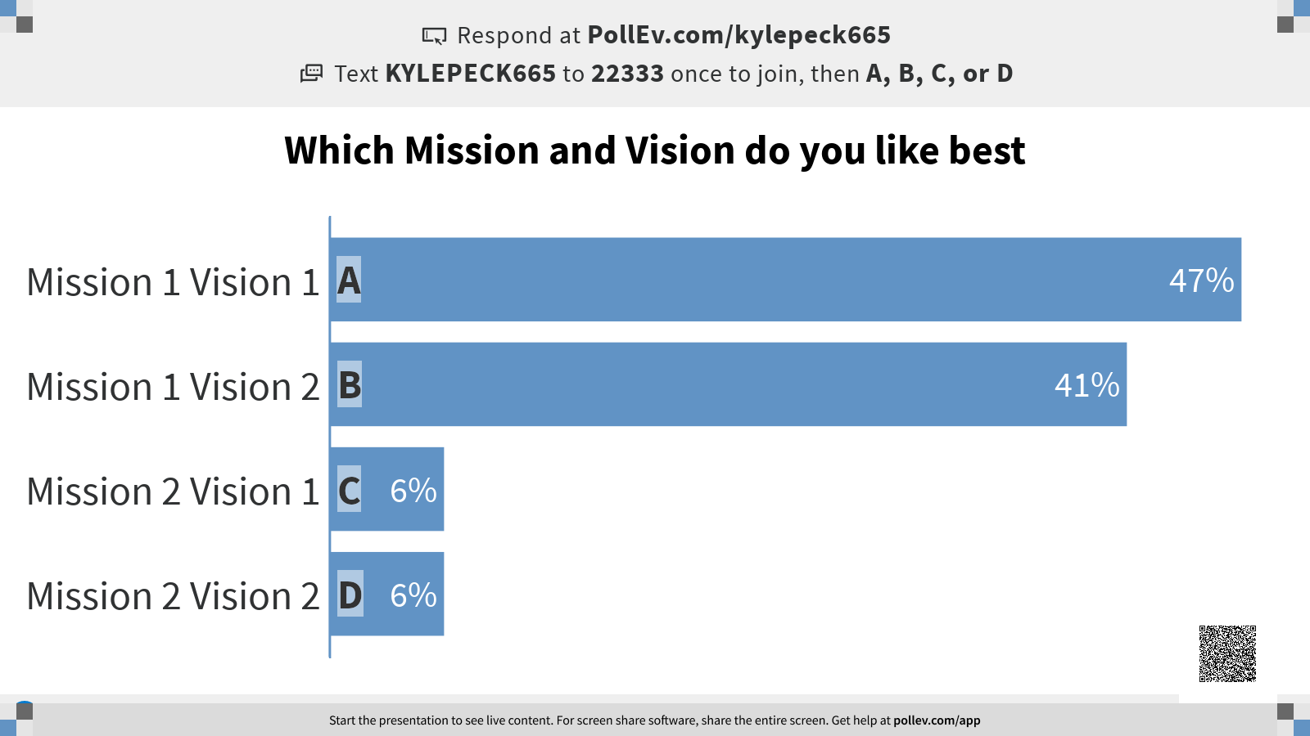

Slide 48


Slide 49

FBLA
--Future Business Leaders of America --
This is a national organization that lets you compete for recognition in several fields, including coding.
FBLA is a culture and a is recognized by most business leaders. If you do well with FBLA it will help you in the future.
AND IT’S SUPER FUN TO BE APART OF!

Slide 50


FBLA - BAAs
Here are some things that we are going to do this year:
Community Service - you will be expected to volunteer sometimes
Fundraising - Please help us out but you are not required to do this
BAAs - This is a year long process and will take time.

Slide 51
